Slide 1
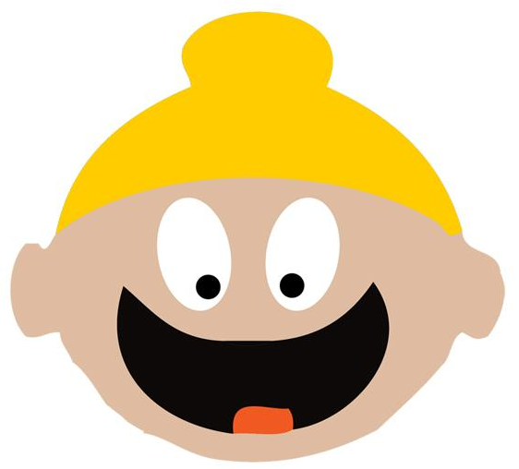
Who Are The Sikhs?
@SikhMum
For Nursery – Year 2 group
Notes:
Today I would like to talk to you about a very important person in Sikh history. Guru Nanak is the founder of the sikh faith. The Sikh faith is one of the largest world religions. There were approx. 23 mill Sikhs worldwide with most of them living in India, Punjab.
Sikhs are now living worldwide and contribute to society like many other communities.
This year – Sikhs are celebrating 550 years of Guru Nanaks birth. That means that if 550 years ago, Guru nanak was not sent by God, those 23 mil people would not exist – isn’t that amazing!!!!!! (12 November 2019)
So lets learn more about guru Nanak

Slide 2
Who Are The Sikhs?
5 largest faith in the whole world
Sikh means learner. We are always learning.
The founder of the Sikh faith is Guru Nanak Dev Jee
Before 1469 in India:
Casteism
Sexism
Ritualism
@SikhMum
For Nursery – Year 2 group
Notes:
The language will need to be adapted for the age group and for nursery and reception, I wouldn’t give too much detail. See below:
Before 1469 in india, there were many bad things happening. The people were not kind to one another. The boys and men were really mean to the girls and men and wouldn’t let Girls do anything.
There was a thing call Castism (it still exists today). Its when someone believes they are better than someone else because of the money they have and the job they do.
The people were also taking part in a lot of ritualism. This is like, bowing to statues and washing your body at special rivers to get blessings from god.
Guru Nanak challenged all these things. He said, how can a rich man be better than a poor many if the rich man is unkind and not sharing his things with others?
He said that, Girls are the ones that have babies and make the kings of the world, girls nurture and bring love to the world. How can she not be equal to a boy, she is more important! He also said that if you want blessings from God, meditate on your breath and Gods names, serve humanity and live an honest life.
The people started to realise the truth in Guru Nanaks message and started to follow his teachings.

Slide 3
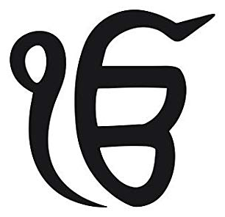
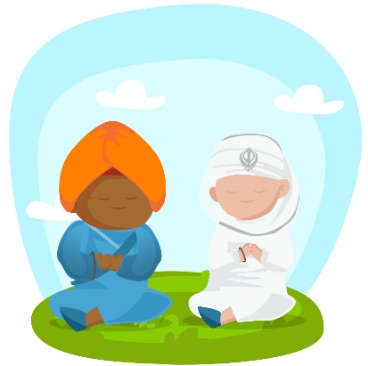
What was Guru Nanak’s message
There is one God for all – ik onkar
There is no love for God, if you cannot remember and meditate on God
Equality for all: Men and women, poor and rich
To reach God, you must have good actions and thoughts
Share with the needy
Be truthful
Love and respect all
Notes:
Guru Nanak brought us the understanding that there is one God for all and that God is not a person or being, but an omnipresent force that is all around us and inside all of us. God had many names, Allah, Ram, Nirankar, Niranjan, Vaheguru, Kudar, Jesus
Meditation is the foundation of sikhi (remember not to use Sikhism – Sikhi is not an ism) Meditation can be done in all faiths, by repeating the name of God over and over 24/7 – many Sikhs meditate with their breath – which is mentioned in the Sikh holy scriptures (saas Giras)
Equality – Before the coming Guru Nanak was sent to earth by God, there was many practices that were happening by other faiths across the world. Women were not allowed to have jobs, or meditate or sit in congregation. Women were treated like they are lower than men. But Guru Nanak came and said that loving God is to love all and treat all equally. Guru Nanak said that women had the same rights as men. (give an example here… If boys can play football so can girls, right?) The same was happening with Poor people. Those that did not have a lot of money, rick people treated them very badly, but Guru nanak said this is wrong. And stopped people doing this.
Guru Nanak said that if you want to meet and experience God, we must have good actions… the things we do has to be kind and caring, and the thoughts we have in our minds has to be positive.
What we have of our own, we must share with others. This is why Sikhs have a free vegetarian kitchen at every Gurdwara around the world. (Sikh place of worship –do not say temple – temple is a mandir. Muslims only use mosque, Christians Church, Jews synagogue – Sikhs have the Gurdwara Sahib)
Being truthful is very important. Guru Nanak sahib that higher than speaking the truth, we must live a truthful life. Every aspect of our life has to be true. .
Guru Nanak wanted us to love and respect everyone, even if we didn’t agree with one another.

Slide 4
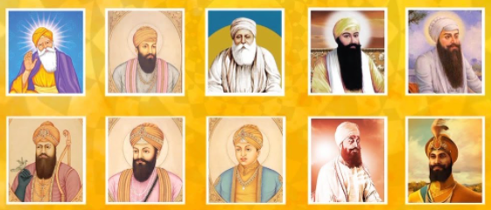
The Light of God
One light in 10 bodies
Guru Granth Sahib Jee – Living Guru of the Sikhs
Guru Granth Sahib is the word of God
Guru Granth Sahib has writings from Muslims & Hindu’s
Guru Granth Sahib is all written in poetry and is recited or sung (in what we call Kirtan)
Notes:
Sikhs believe that God sent Guru Nanak to share the sikh way of life with the world. God took a piece of themselves and put that light into Guru Nanak. When Guru Nanak’s body was ready to go back to God, the piece of God, the light travelled into the next Guru and the next…. Every Guru Jee added something new to the faith of Sikh until it reached the 10 guru.
Do the Jug of water and 11 cups practical for the children here
Guru Gobind Singh was the 10 th Guru, he knew the message of Sikhi was complete and all the hymns that were written by the Gurus, were compiled into the Guru Granth Sahib Jee the living Gurus of the Sikhs. The Light of God that travel from god to Guru Nanak and all the way through to the 10th Guru, was passed to the holy scriptures. The Sri Guru Granth Sahib Jee.

Slide 5
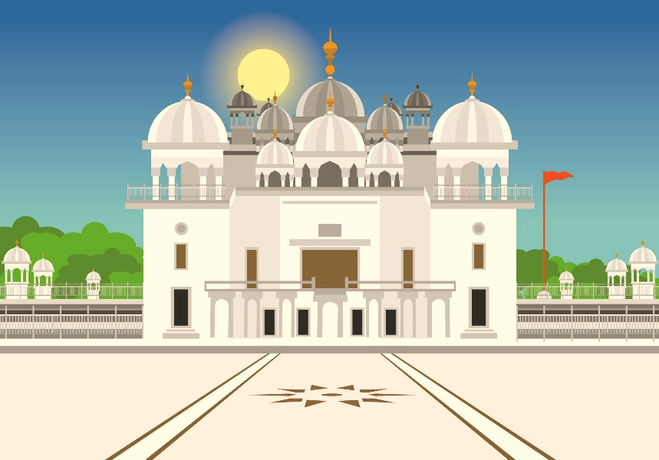
The Sikh Place of Worship
The Sikh place of worship is the GURDWARA SAHIB (We do not call it a temple)
We meditate by sitting in prayer pose with our eyes closed – facing Guru Granth Sahib
Sikhs pray for all of humanity
Sikhs pray for our soul to be happy and ask God to help us follow the teachings of Guru Nanak
Sikhs do seva (selfless service), serving free vegetarian food
Kirtan (Singing Gods praises together)
We listen to talks about God and Sikhi
We raise money and serve food to the homeless
We have holiday camps, where we learn about Sikhi and spend time with our friends
ANYONE CAN VISIT THE GURDWARA AND HAVE A FREE MEAL
@SikhMum
For Nursery – Year 2 group
Notes:
Talk through what we do at the Gurdwara sahib, how we celebrate, explain that this is what we do instead of Christmas and Easter – which are Christian celebrations
Make it fun and let him see your passion and positive emotion

Slide 6
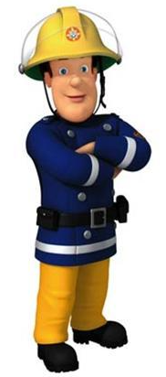
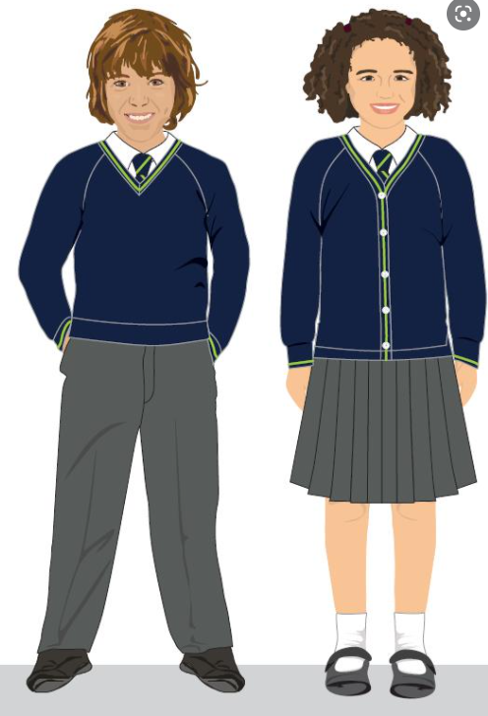
The Sikh Identity
Sikhs have a VERY distinct identity.
During the times of our Guru, there were bad people being very mean to the poor people. The Sikhs were protectors.
QUIZ!!
@SikhMum
For Nursery – Year 2 group
Notes:
BE INTERACTIVE – THIS IS WHAT WE NEED THE CHILDREN TO REMEMBER!!!
Sikhs have a VERY distinct identity. (explain what distinct and identity means)
During the times of our Guru, there were bad people being very mean to the poor people. The Sikhs were protectors.
QUIZ
WHY DO YOU ALL WEAR A UNIFORM TO SCHOOL?
So you all feel a part of the same community or team
WHO DO THE POLICE HAVE A SPECIAL UNIFORM?
So you can see them from far away and know they can help you
THIS IS WHY THE SIKHS HAVE A SPECIAL UNIFORM TOO.

Slide 7
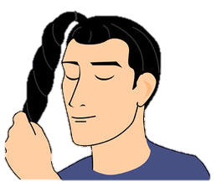
The Sikh Identity
Your Sikh friends (Boys & GIRLS) also have a uniform.
When we are little, we wear a PATKA
When we get older, we wear a DASTAAR/KESKI
In English this is called a TURBAN
Under the head covering is KESH (uncut hair).
Sikhs do not cut their hair, from the top of head to the tip of their toe.
Sikhs wear the PANJ KAKKAR (5k’s) as a part of their uniform.
@SikhMum
For Nursery – Year 2 group
Notes:
After talking through the slide, remind the children that just like a Christian priest or nun wears a dog collar or habit, Sikhs wear their head covering and panj kakaar
Just like a muslim wears a hijab , Sikhs wear their head covering and panj kakaar
Just like a jewish person wears a skull cap, Sikhs wear their head covering and panj kakaar
Respecting each other important. Loving everyone for what and who there are is important. We should look at someone and feel that they are different so this is wrong… instead, if we have questions, we should ask those questions with love and politeness.
It is very important we DO NOT TOUCH our sikh friends identity, just like we would touch or pull someones plats, hijab, or afro. Can you repeat that? ‘WE DO NOT TOUCH THE TURBAN/PAKTA’
NEXT SLIDE leads to….
Do you have any questions?

Slide 8
Questions??
Notes:
If you don’t know the answer to a questions, be comfortable to say, I will check and let you know… PLEASE DO NOT ANSWER A QUESTION YOU DO NOT KNOW THE ANSWER TO OR ANSWER ACCORDING TO YOUR OWN BELIEFS.
We have to be authentic and share the truth of sikhi, according to Gurbani, Rehatnamay and Rehat Maryada (Sikh code of conduct)

