Slide 1
Guru Nanak Dev Jee
@SikhMum
For Nursery – Year 2 group
Notes:
Today I would like to talk to you about a very important person in Sikh history. Guru Nanak is the founder of the sikh faith. The Sikh faith is one of the largest world religions. There were approx. 23 mill Sikhs worldwide with most of them living in India, Punjab.
Sikhs are now living worldwide and contribute to society like many other communities.
This year – Sikhs are celebrating 550 years of Guru Nanaks birth. That means that if 550 years ago, Guru nanak was not sent by God, those 23 mil people would not exist – isn’t that amazing!!!!!! (12 November 2019)
So lets learn more about guru Nanak

Slide 2
Who is Guru Nanak Dev Jee?
Who is Guru Nanak Dev Jee?
Born in 1469 – 550 years ago!
Parents were Mata Tripta Jee and Meta Kalu Jee
Sister was Bibi Nanaki Jee
His wife was Sulakani Jee and he had two son’s,
Lakhmi Das and Sri Chandi
His best friend was Bhai Mardana Jee – he was a
Muslim
@SikhMum
For Nursery – Year 2 group
Notes:
Who is Guru Nanak Dev Jee?
Born in 1469 – 550 years ago! – Mention he was born in Talwandi, which is now called Nankana Sahib - Pakistan
Parents were Mata Tripta Jee and Meta Kalu Jee – his mother was very religious and knew he was special . When he was born, he did not cry.
Sister was Bibi Nanaki Jee – His sister was the first person to bow to Guru nanak and could see God inside him
His best friend was a saintly Muslim man and musician called Bhai Mardana Jee

Slide 3
Why did Guru Nanak Dev Jee come?
At the time in Northern India, the poor people were very unhappy.
If you did not have money or a job, the rich did not treat you nice
Girls were not allowed to live like the boys
Rich people would do bad things to the poor
There was not a lot of kindness in peoples
actions and words
@SikhMum
For Nursery – Year 2 group

Slide 4
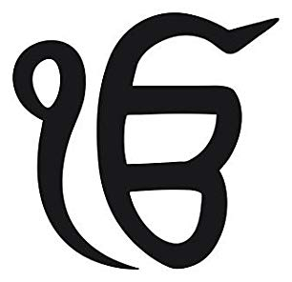
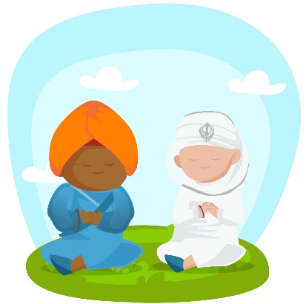
What was Guru Nanak’s message
There is one God for all – ik onkar
There is no love for God, if you cannot remember and meditate on God
Equality for all: Men and women, poor and rich
To reach God, you must have good actions and thoughts
Share with the needy
Be truthful
Love and respect all
Notes:
Guru Nanak brought us the understanding that there is one God for all and that God is not a person or being, but an omnipresent force that is all around us and inside all of us. God had many names, Allah, Ram, Nirankar, Niranjan, Vaheguru, Kudar, Jesus
Meditation is the foundation of sikhi (remember not to use Sikhism – Sikhi is not an ism) Meditation can be done in all faiths, by repeating the name of God over and over 24/7 – many Sikhs meditate with their breath – which is mentioned in the Sikh holy scriptures (saas Giras)
Equality – Before the coming Guru Nanak was sent to earth by God, there was many practices that were happening by other faiths across the world. Women were not allowed to have jobs, or meditate or sit in congregation. Women were treated like they are lower than men. But Guru Nanak came and said that loving God is to love all and treat all equally. Guru Nanak said that women had the same rights as men. (give an example here… If boys can play football so can girls, right?) The same was happening with Poor people. Those that did not have a lot of money, rick people treated them very badly, but Guru nanak said this is wrong. And stopped people doing this.
Guru Nanak said that if you want to meet and experience God, we must have good actions… the things we do has to be kind and caring, and the thoughts we have in our minds has to be positive.
What we have of our own, we must share with others. This is why Sikhs have a free vegetarian kitchen at every Gurdwara around the world. (Sikh place of worship –do not say temple – temple is a mandir. Muslims only use mosque, Christians Church, Jews synagogue – Sikhs have the Gurdwara Sahib)
Being truthful is very important. Guru Nanak sahib that higher than speaking the truth, we must live a truthful life. Every aspect of our life has to be true. .
Guru Nanak wanted us to love and respect everyone, even if we didn’t agree with one another.

Slide 5
How can we implement Guru Nanak’s teachings into our life?
There is one God for all – ik onkar
Meditation
Equality
Good actions and thoughts
Share with the needy
Be truthful
See & try to understand that God is in all people
We can try to meditate daily
We treat everyone how we want to be treated
Try our best to have positive thoughts and use our hands to do good work
Help others, even at home – we can help by keeping our room clean
Tell the truth always and be truthful with ourselves
Notes:
Do this as an interactive workshop – get the audience to think of examples and report back

Slide 6
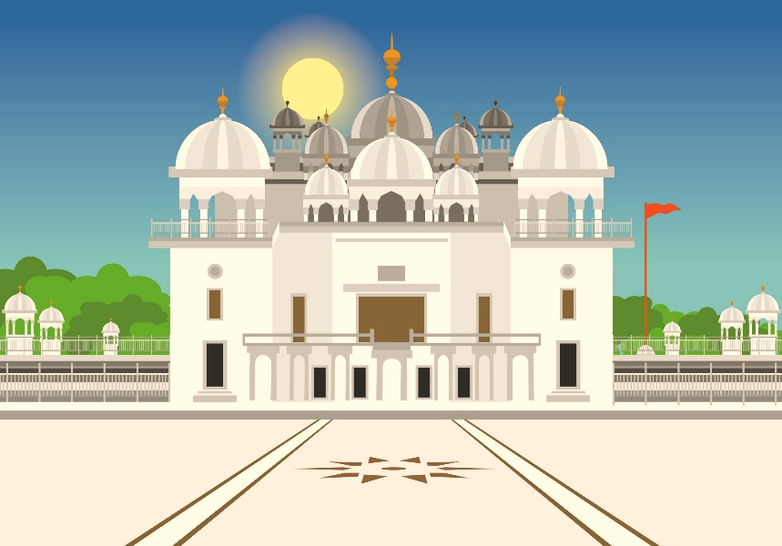
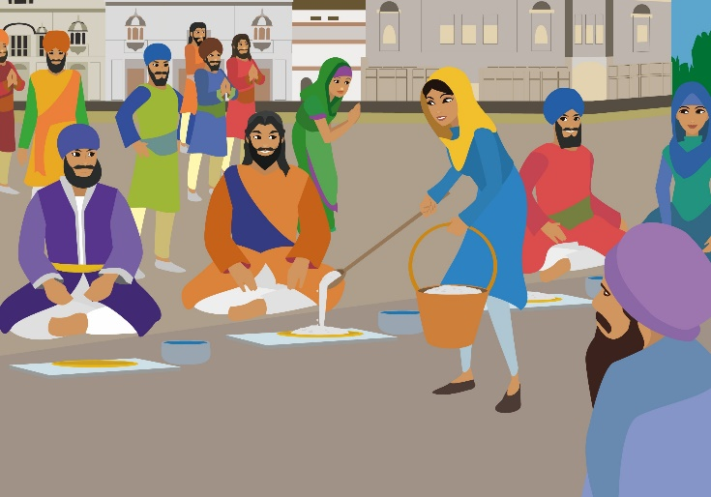
How do Sikhs celebrate?
Going to the Gurdwara Sahib (Sikh place of Worship)
At the Gurdwara, we meditate by sitting in prayer pose with our eyes closed
Sikhs pray for all of humanity
Sikhs pray for our soul to be happy and ask God to help us follow the teachings of Guru Nanak
Sikhs do seva (selfless service), serving free vegetarian food
Exchanging gifts
We give out food to the homeless
Doing sparklers and fireworks
Making and giving Gurpurab cards
@SikhMum
For Nursery – Year 2 group
Notes:
Talk through what we do at the Gurdwara sahib, how we celebrate, explain that this is what we do instead of Christmas and Easter – which are Christian celebrations

Slide 7
Questions?

